Slide 1

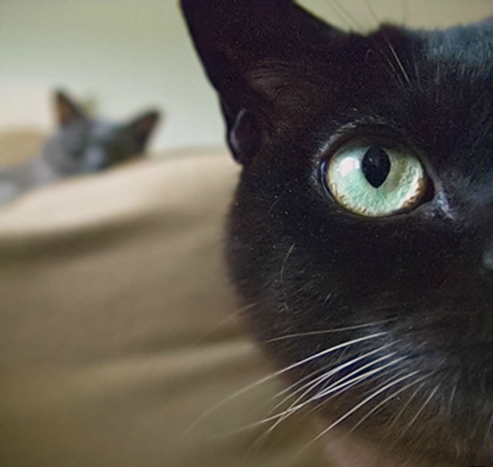
Data Science from the Perspective of an Applied Economist
Scott Nicholson – @scootrous

Slide 2
This Talk
A 30 minute Applied Economics PhD
Will make you a better data scientist
Exhibits the value-add of econometrician on a data science team
Notes:
what i want to do...applied econ phd in less than 30 minutes
what i'm going to talk about is a set of intuition and methodoligies that economists use to answer a certain set of questions
and in the process make you a better data scientist AND understand the contributions economists can make to DS teams
the type of questions that we're going to talk about is teasing causation from correlation
the typical toolkit of data scientists of machine learning algorithms or fitting statistical models is insufficient for identifying causality from observational data
Typically we use A/B tests to send the right email, find the best UX, make the most $, but what if we can’t run an A/B test?
What if we only have observational data? How can you get causation out of data?
My perspective…about me
gdp

Slide 3
Recent Research by Economists
Why Do Mothers Breastfeed Girls Less than Boys? Evidence and Implications for Child Health in India
Family Violence and Football: The Effect of Unexpected Emotional Cues on Violent Behavior
Does Terrorism Work?
Racial Discrimination Among NBA Referees
The Effects of Lottery Prizes on Winners and Their Neighbors: Evidence from the Dutch Postcode Lottery
Notes:
Economists are interested in a wide variety of topics where data can inform us of the world through better understanding incentives and individuals’ decision making processes.
For applied economists doing these kinds of research, what is in their toolkit?

Slide 4
What Makes an Applied Economist?
Intuition
Methods
Curiosity about human decision-making
Attention to underlying mechanisms

Slide 5
If you care about prediction,
think like a computer scientist.
If you care about causality,
think like an economist.
Notes:
Black box, prediction, optimizing
Decision-making, human behavior, learning about the world

Slide 6
Gradations of Identifying Causal Relationships
Randomized controlled experiments
Natural experiments
Regression discontinuity
Panel data econometrics
Instrumental variables
Notes:
Spectrum…Decreasing in confidence of gaining causality
If we can’t run an experiment, what can we do with observational data?

Slide 7

  Randomized Controlled Experiment
  The Gold Standard
Notes:
This technique needs no explanation. We are all familiar with controlled experiments either in the lab, an email or a UX on the web. This is the gold standard when you have the ability/time/resources to construct the experiment.
What if you only have observational data?
What if you only have data from the past and need to disentangle causality from correlation?
What if the experiment you want to run is not feasible or unethical?
Example: examining the effects of pre-kindergarten classes on student achievement.

Slide 8

  Natural Experiment
  How does having been a child soldier in Uganda affect lifetime earnings and likelihood of voting?

Slide 9

  Natural Experiment
  How does a 100 point decrease in SAT score affect likelihood of entering a ‘top’ school?
Notes:
Natural experiment: treatment groups were assigned without researcher intervention
Another method for disentangling causality from correlation is to exploit natural variation in the data.
Look for random sources of variation that are correlated with the outcome variable but uncorrelated with the explanatory variable (feature)
What is the value of an extra 100 points on the SAT? We can follow outcomes of these students to find out.
Email outage
Voter fatigue
Server outages, search results

Slide 10
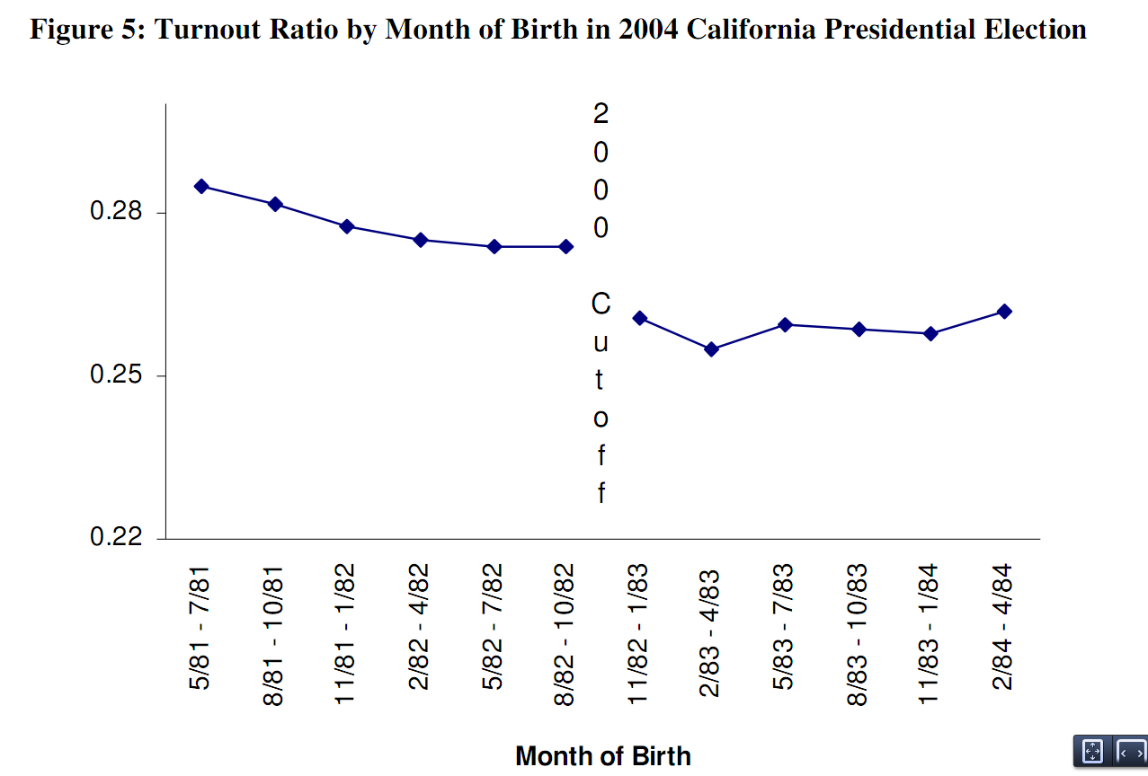
  Regression Discontinuity
  Does voting increase the likelihood of voting in the next election?
Turnout rate in 2004 election
Just eligible to vote in 2000 election
Just NOT eligible to vote in 2000 election
Notes:
Regression discontinuity: assignment to treatment/control determined by a threshold that is exogenously decided by external factors
Question:
How much does voting in one election affect your likelihood of voting in the next election?
Problem:
Also correlated with age. Older people exhibit higher turnout.
Selection issues for why people choose to vote
Voting rights are in the constitution! Can’t randomly vary them.
What if you turned 18 on the last day eligible voters were able to register for a presidential election.
Let’s say 2008 where Obama really inspired a lot of young people.
What if your friend turned 18 the day AFTER the final registration date.
You were able to vote and your friend wasn’t.
Turns out you are 1) more likely to vote in subsequent elections and 2) more likely to have the same party affiliation as who you voted for in that previous election.

Slide 11
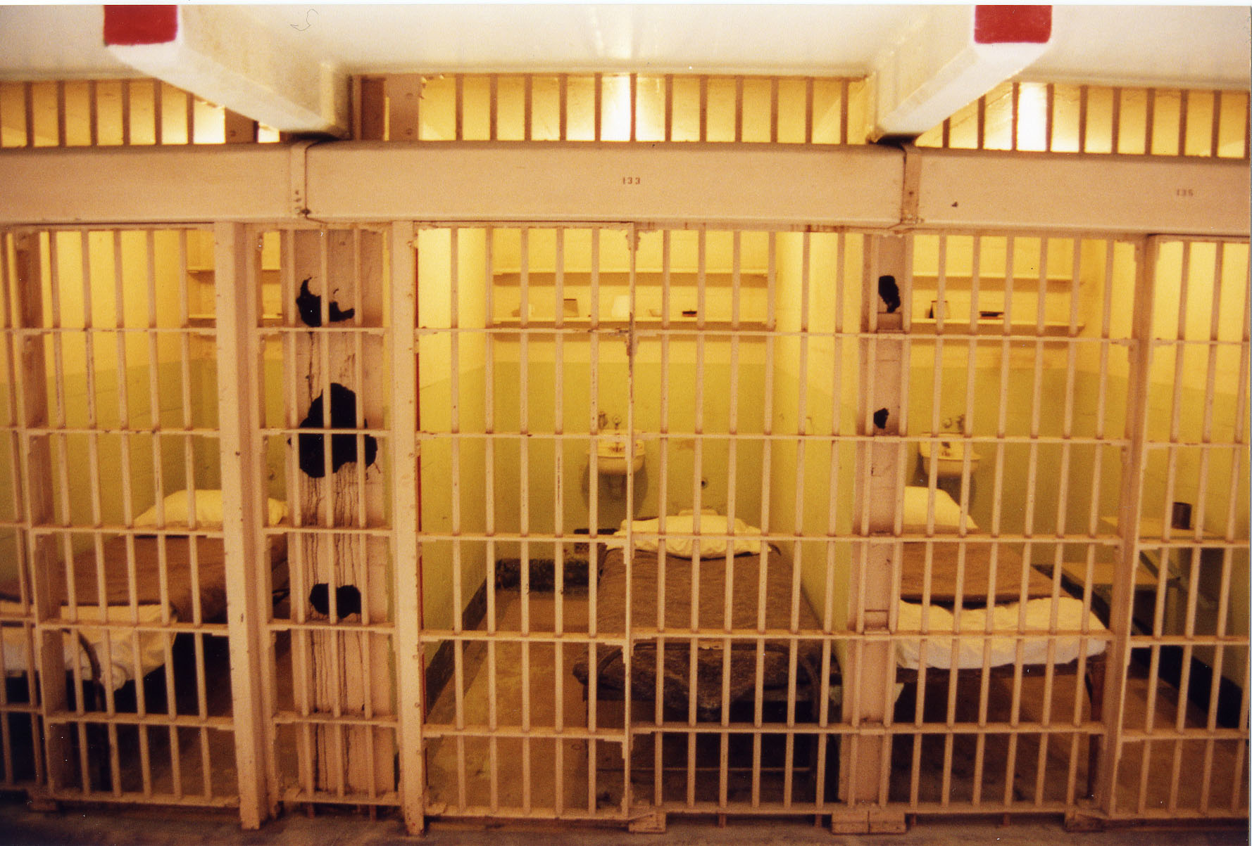
  Regression Discontinuity
  Does being a prisoner in a maximum security prison increase the likelihood of prisoner misconduct?
Notes:
QUESTION
Does being assigned to a high-security prison make a prison more likely to engage in misconduct?
PROBLEM
More dangerous prisoners tend to be assigned to higher-security prisons
SOLUTION
Classification score…similarly-dangerous prisoners, but sent to prisons of different security levels
IMPLEMENT
Interact classification score with cutoff

Slide 12
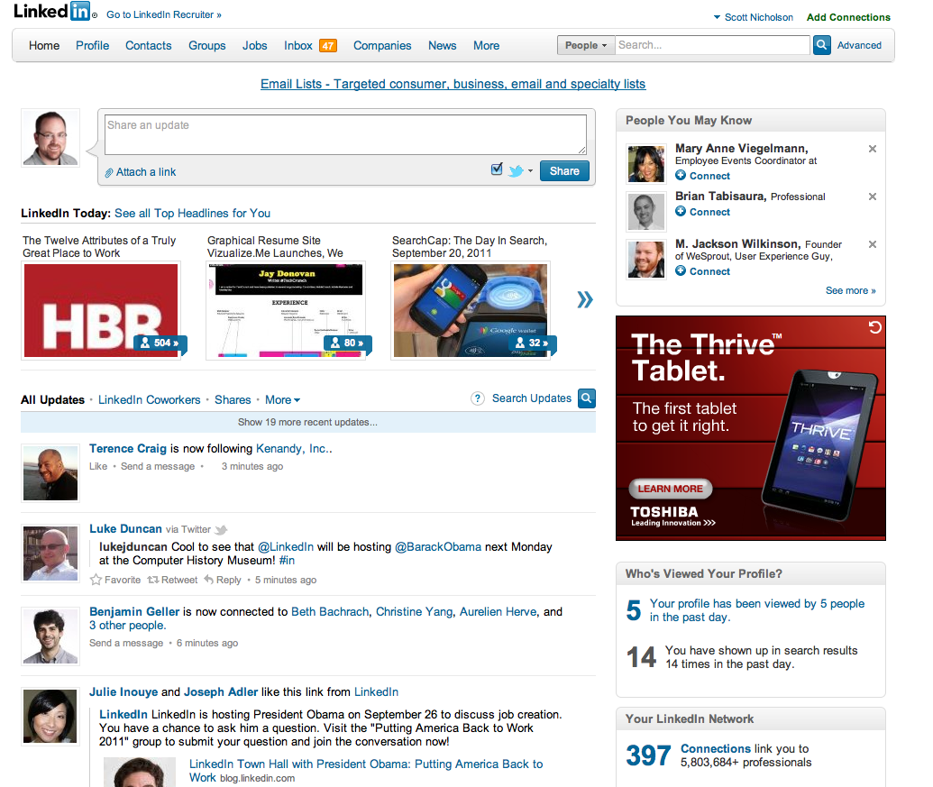
  Panel Data Econometrics
  Which site activities are predictive of future engagement?
Notes:
Panel data: Following observations over time allows us to control for subject-specific (unobservable) effects
Going further away from the gold standard of A/B testing and moving closer to establishing predictive power

Slide 13
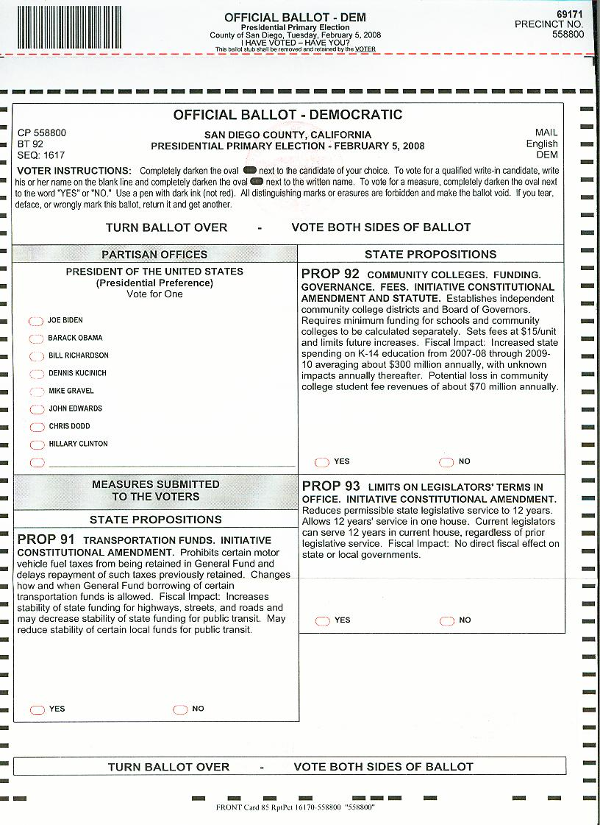
  Panel Data Econometrics
  Do voters experience ‘fatigue’ from long ballots?
Notes:
The next level of gradations…
QUESTION
Do voters tire and not vote on some contests as they move down the ballot?
PROBLEM
Infeasible to run a RCE
Contests less salient as you move down the ballot
Some precincts may be more likely to just not vote
SOLUTION
Panel data: Following observations over time allows us to control for subject-specific (unobservable) effects
Plus: natural experiment allows us to observe a contest at different positions on the ballot
This one is actually a combination of panel data & natural experiment
Voter fatigue confounded with lower information contests appearing further down the ballot
Solution
For the same state proposition, we observe variation in ballot position across voters in different precincts due to different sets of local offices on ballot. Controlling for some other stuff, we can estimate the causal effect from voter fatigue from moving a contest 1 position further down the ballot.
Methodology
Fixed and random effects estimators

Slide 14

  Instrumental Variables
  We believe that LinkedIn helps people find better professional opportunities. Can the weather help us establish causation?
Notes:
Instrumental variables: For your predictor that is correlated with a confounding factor, find an “instrument” that is correlated with your predictor and dependent variable but not the confounding variable
Disentangling causation from correlation really means that we need to deal with the confounding factor that is correlated with both our outcome variable and our explanatory variable.
Finding an instrument means to find a variable that is correlated with the explanatory variable

Slide 15
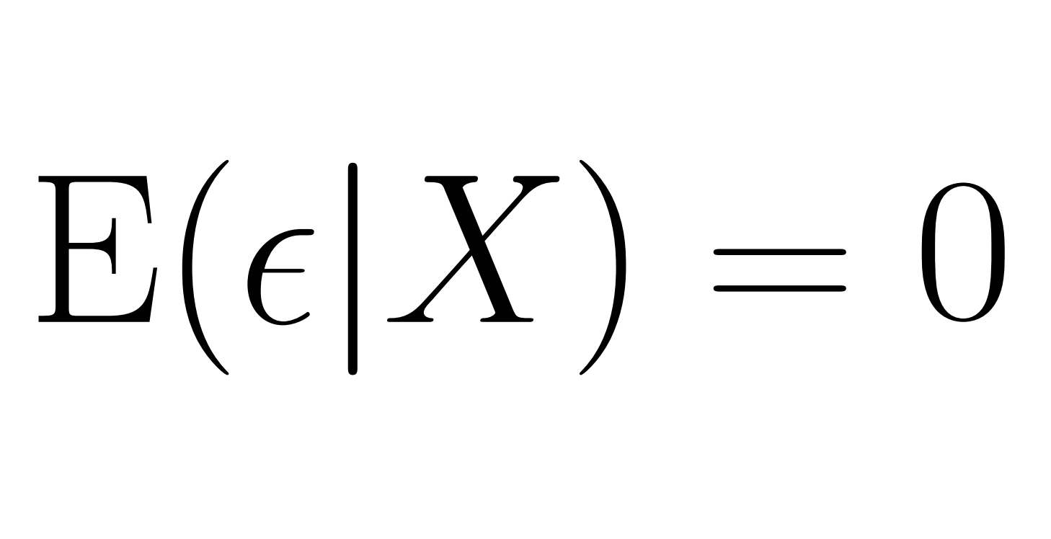
What Do Economists Think About the Most?

Slide 16
If you care about prediction,
think like a computer scientist.
If you care about causality,
think like an economist.
Notes:
At this slide, wrap it all up. Economists bring a specialized skill set to the table, think about causality before all else. Some skills gap but

Slide 17
Sources
Blattman, Christoper; Jeannie Annan. 2010. The Consequences of Child Soldiering. The Review of Economics and Statistics, November 2010, 92(4): 882–898
Meredith, Marc. 2009. Persistence in Political Participation. Quarterly Journal of Political Science 4(3): 186-208
Richard A. Berk; Jan de Leeuw. 1999. An Evaluation of California's Inmate Classification System Using a Generalized Regression Discontinuity Design. Journal of the American Statistical Association, Vol. 94, No. 448. (Dec., 1999), pp. 1045-1052
Augenblick, Ned; Scott Nicholson. 2011. Ballot Position, Choice Fatigue, and Voter Behavior. Submitted, under review. http://faculty.haas.berkeley.edu/ned/Choice_Fatigue.pdf
Photo credit (cats): Eric Cheng / Lytro

Slide 18
  We’re hiring!
  snicholson@linkedin.com

Slide 19
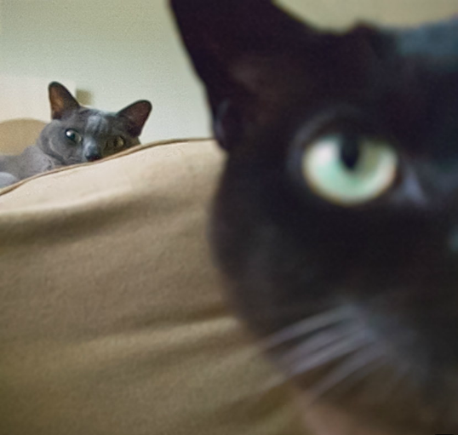
Thank You!
Scott Nicholson – @scootrous
Notes:
`

